Slide 1

F1 Driver Performance Analysis — 2025
A concise, data-driven evaluation of driver performance beyond championship points
Prepared by: Surya Mani Deep
Date: September 2026

Slide 2
Project Overview & Objectives
Project Overview:
This project analyses Formula 1 driver performance during the 2025 season using race and qualifying data.
Multiple performance metrics are combined to provide a broader view of driver performance across the season.
The analysis covers race results, qualifying performance, consistency, reliability, and race execution, with the results combined into a weighted Overall Performance Score.
Objectives:
Analyse driver performance throughout the 2025 season.
Compare drivers across multiple performance metrics.
Evaluate race and qualifying performance.
Measure consistency and reliability.
Develop a weighted Overall Performance Score.
Build an interactive Power BI dashboard to visualise the analysis.

Slide 3
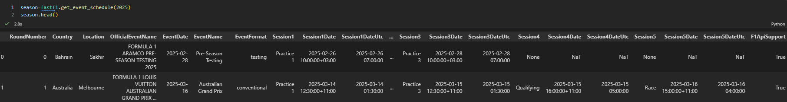
Data & Technology Stack
Tools: FastF1 → Python (data extraction) → Pandas (cleaning & aggregation) → Power BI (interactive visualization).
2025 Formula 1 Season race and qualifying session data were collected using the FastF1 Python library.
The dataset includes driver and team information, qualifying positions, race finishing positions, championship points, wins and podiums, DNF / retirement information, session and race details.
Workflow: FastF1 → Python scripts → Pandas cleaning & summary CSVs → Power BI import and dashboard build.

Slide 4
Performance Metrics
The analysis uses 8 key metrics to evaluate different aspects of Formula 1 driver performance throughout the 2025 season.
🏁 Race Performance:
Total Points — Championship points earned during the season.
Win Rate — Percentage of races won.
Podium Rate — Percentage of races finished on the podium.
Average Finish Position — Average finishing position across races.
📊 Consistency & Reliability:
Finish Consistency — Measures variation in race finishing positions.
DNF Rate — Percentage of races not finished.
⏱️ Qualifying & Race Performance:
Average Qualifying Position — Average position achieved in qualifying.
Average Qualifying–Race Gap — Average difference between qualifying position and race finishing position.

Slide 5
Scoring Methodology
Different weights were assigned based on the role of each metric in evaluating overall driver performance.
Metric Weights:
Metric | Weight
Total Points | 25%
Win Rate | 15%
Podium Rate | 15%
DNF Rate | 15%
Average Finish Position | 10%
Average Qualifying–Race Gap | 10%
Average Qualifying Position | 5%
Finish Consistency | 5%

Slide 6
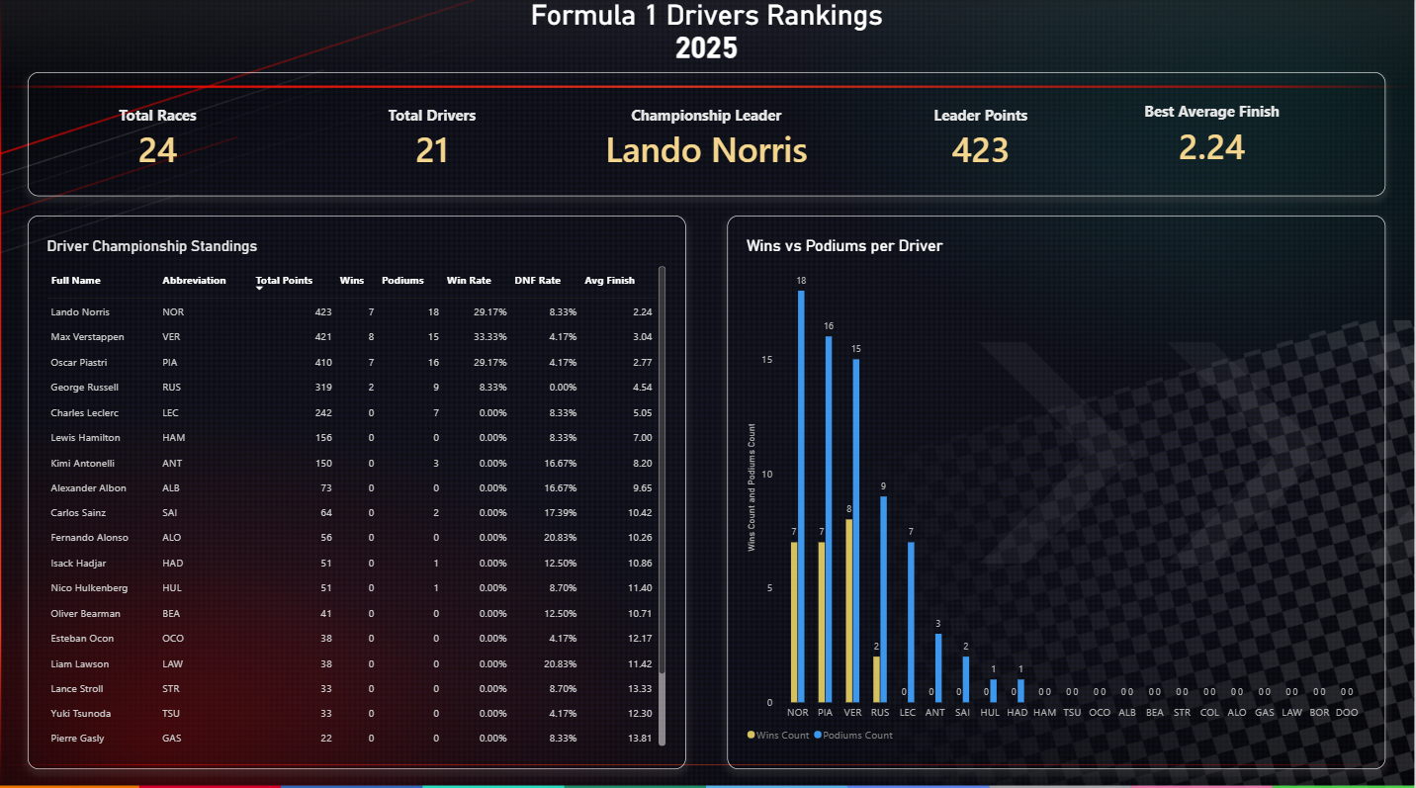
Power BI Dashboard — Key Views

Slide 7
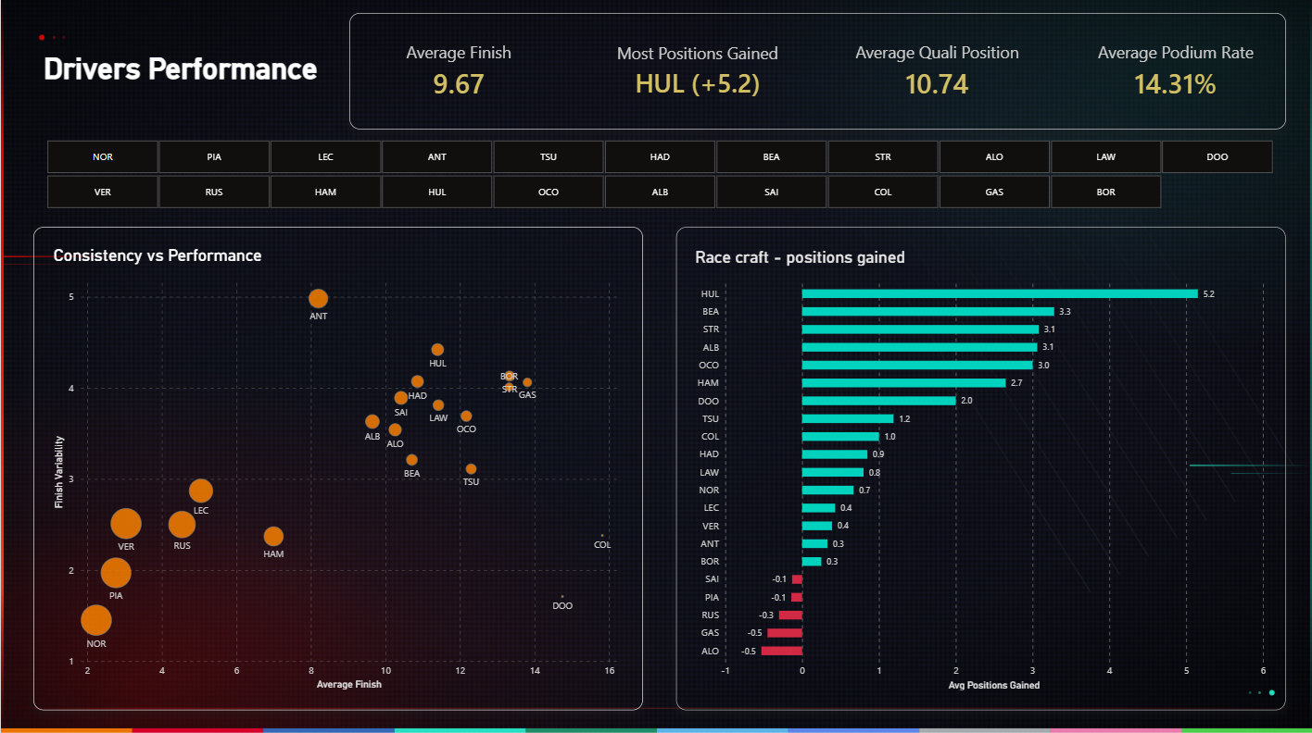
Power BI Dashboard — Key Views

Slide 8
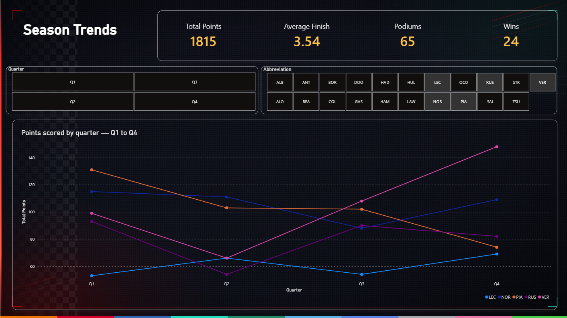
Power BI Dashboard — Key Views

Slide 9
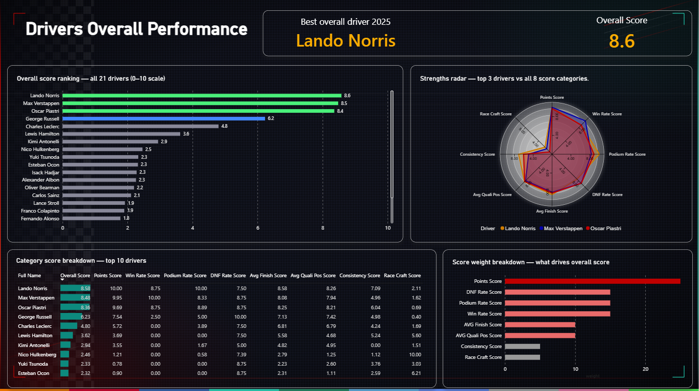
Power BI Dashboard — Key Views

Slide 10
Analytical Insights
The 2025 championship was decided by a very small margin
Lando Norris finished with 423 points, only 2 points ahead of Max Verstappen, showing how closely matched the season was at the top.
Race wins do not tell the entire championship story
Max Verstappen recorded 8 wins, compared with 7 each for Norris and Piastri, but Norris finished ahead on total championship points.
Qualifying pace does not completely determine race results
The Qualifying–Race Gap shows how drivers convert their starting position into a final race result, highlighting gains or losses during the race.
Race execution can compensate for a weaker qualifying result
Drivers who regularly gain positions during races can achieve strong results even when their qualifying position is not among the best.
Podium rate provides more context than wins alone
A driver may not have the most victories but can still produce a strong season by consistently finishing within the top three

Slide 11
Limitations & Future Improvements
Limitations
Metric Coverage: Only 8 metrics are included; factors like tyre management, race pace, and strategy are not covered.
Car Performance: Driver results are strongly influenced by car performance and cannot be completely isolated in this analysis.
Race Strategy: Pit-stop decisions, race strategy, and tactical choices are not included in the scoring model.
Safety Cars: Safety-car periods can influence race outcomes but are not included in the performance scoring.
Mechanical Failures: The model does not distinguish between driver-caused retirements and mechanically induced DNFs.
Future Improvements
Tyre compound and tyre degradation analysis.
Pit-stop performance.
Overtaking and position-change analysis.
More advanced statistical analysis.
Analyse performance across track types.

Slide 12
Conclusion
This project analysed 2025 Formula 1 driver performance using race and qualifying data collected through FastF1 and processed with Python and Pandas.
Eight performance metrics were developed to evaluate race performance, qualifying performance, consistency, and reliability. These metrics were combined using a weighted scoring model to calculate an Overall Performance Score for each driver.
The analysis was presented through an interactive Power BI dashboard, allowing driver performance to be explored, compared, and understood across multiple dimensions throughout the season.
Final Outcome:
A complete end-to-end data analytics project transforming Formula 1 data into meaningful driver performance insights.

Slide 13


